Slide 1
Course Code: MS-212 Couse Title: Probability and Statistics
Course Instructor: Ahmed Farid

Slide 2
Text Book: Probability and statistics for engineering and scientist 8th Edition by Walpole, mayer

Slide 3
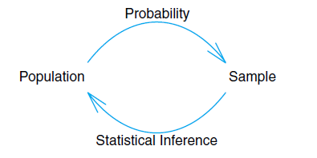

Slide 4
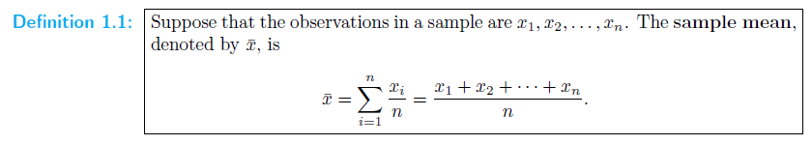
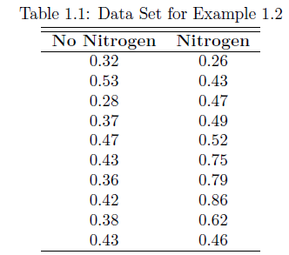

Slide 5
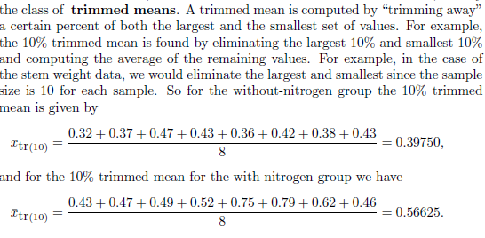
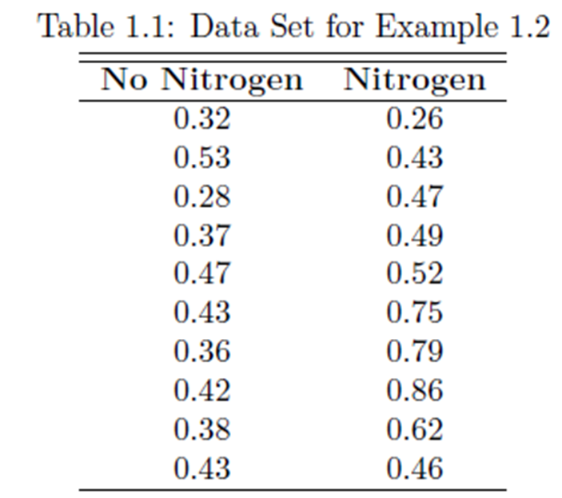

Slide 6
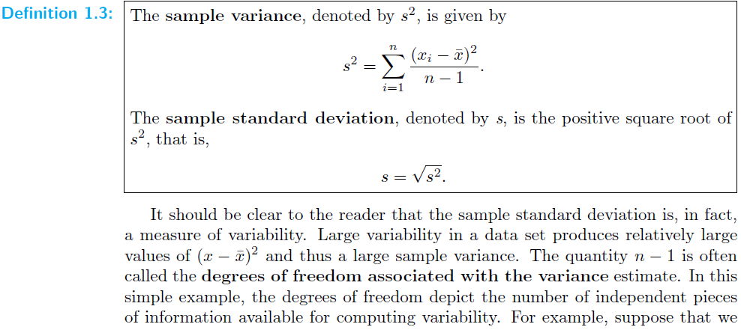

Slide 7
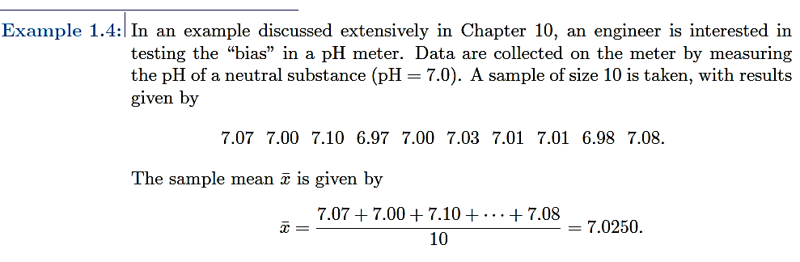
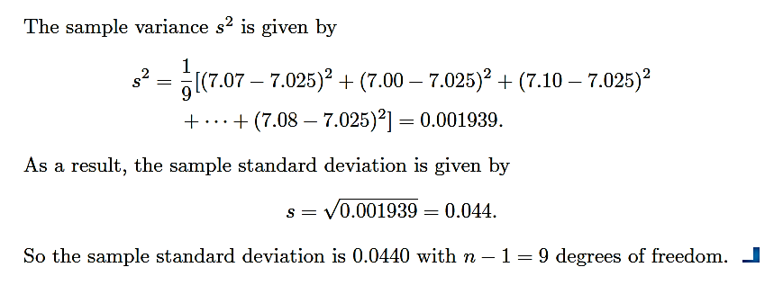

Slide 8
Stem and leaf plot

Slide 9
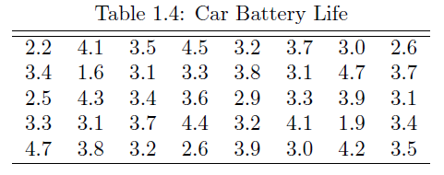
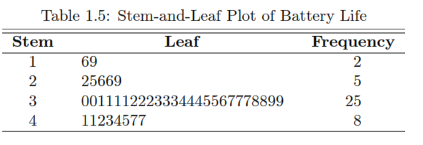

Slide 10
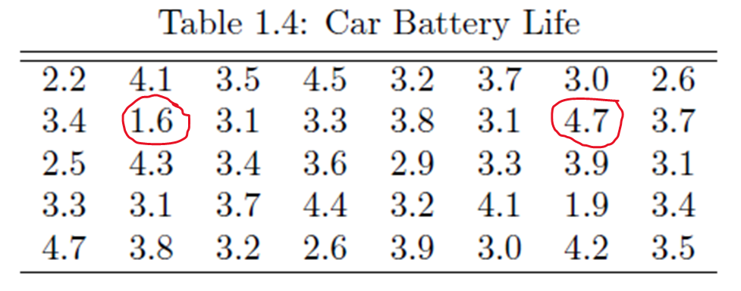
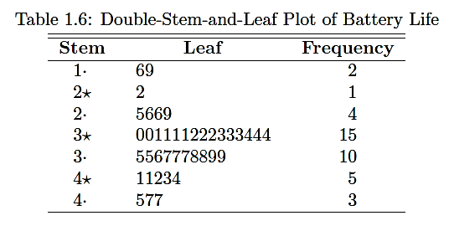

Slide 11
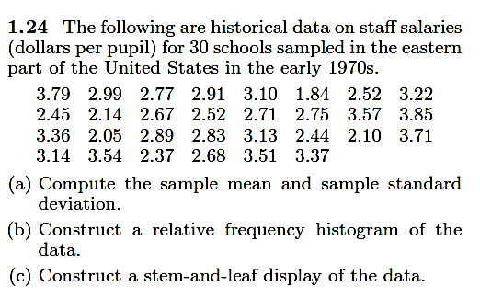

Slide 12
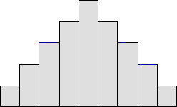
Histogram: Study the shape
Bell-shaped: A bell-shaped picture, shown below, usually presents a normal distribution.

Slide 13
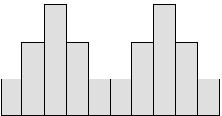
Histogram: Study the shape
Bimodal: A bimodal shape, shown below, has two peaks.
This shape may show that the data has come from two different systems.
If this shape occurs, the two sources should be separated and analyzed separately.

Slide 14
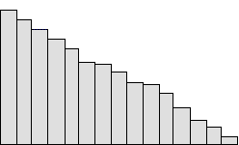
Histogram: Study the shape
Skewed right: Some histograms will show a skewed distribution to the right, as shown below.
A distribution skewed to the right is said to be positively skewed.
This kind of distribution has a large number of occurrences in the lower value cells (left side)
and few in the upper value cells (right side). A skewed distribution can
result when data is gathered from a system with has a boundary such as zero.
In other words, all the collected data has values greater than zero.

Slide 15
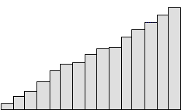
Histogram: Study the shape
Skewed left:
Some histograms will show a skewed distribution to the left, as shown below. A distribution skewed to the left is said to be negatively skewed. This kind of distribution has a large number of occurrences in the upper value cells (right side) and few in the lower value cells (left side). A skewed distribution can result when data is gathered from a system with a boundary such as 100. In other words, all the collected data has values less than 100.

Slide 16
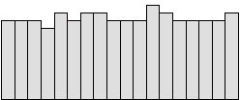
Histogram: Study the shape
Uniform:
A uniform distribution, as shown below, provides little information about the system. An example would be a state lottery, in which each class has about the same number of elements. It may describe a distribution which has several modes (peaks). If your histogram has this shape, check to see if several sources of variation have been combined. If so, analyze them separately. If multiple sources of variation do not seem to be the cause of this pattern, different groupings can be tried to see if a more useful pattern results. This could be as simple as changing the starting and ending points of the cells, or changing the number of cells. A uniform distribution often means that the number of classes is too small.

Slide 17
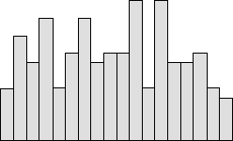
Histogram: Study the shape
Random:
A random distribution, as shown below, has no apparent pattern. Like the uniform distribution, it may describe a distribution that has several modes (peaks). If your histogram has this shape, check to see if several sources of variation have been combined. If so, analyze them separately. If multiple sources of variation do not seem to be the cause of this pattern, different groupings can be tried to see if a more useful pattern results. This could be as simple as changing the starting and ending points of the cells, or changing the number of cells. A random distribution often means there are too many classes.

Slide 18
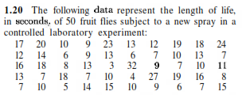
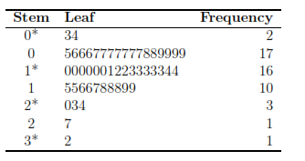

Slide 19



Slide 20
0.2
0.2
0.2
0.3
0.3
0.4
0.4
0.5
0.7
1
1.2
1.3
1.3
1.5
1.5
1.8
2
2.5
3
3.3
4
4.5
4.7
5
5.5
5.6
5.9
6
6
6
6.5

Slide 21
Ex 1.17-1.25

